Slide 1
Microsoft Desktop Optimization Pack Technologies
Microsoft Diagnostics and Recovery Toolset
Powerful Tools to Accelerate Desktop Repair

Slide 2

Agenda
Current Enterprise Issues
The Desktop Optimization Pack
Product Overview
Resources

Slide 3

More Pressure Than Ever On IT
Technology
Change
Security
Cost
Reduction
Keep Business
Up and Running
Increase
Utilization
Increase
Responsiveness
Business Results
And New Value

Slide 4
Addressing Key Enterprise Customer Pain
Scenario Experience
Application Compatibility
Accelerate deployment
Make compatibility testing fast and painless
Simplify corporate image management
Enable anytime, anywhere secured access to applications
Help lock desktops down
Allow customers to mix and match rich and thin clients
in their environment
Enable better application provisioning
Simplify problem resolution and tracking.
Help prevent future issues.
Increase recovery time and functionality.
Protect sensitive data and intellectual property
Ensure laptops are virus-free before connecting to corpnet and
enable vulnerability assessment
Bring new data protection solutions. Lock desktops down.
Monitor usage and ensure deployment policy compliance.
Enable real time tracking of software usage.
Improve PC Manageability –
Drive Down TCO in the OS
Flexible Computing Models
(e.g. Thin client computing)
Diagnostics and Help Desk
Protect data lost/stolen PCs
Make PCs Safe to Use –
Anywhere, Any Time
Software Asset Management

Slide 5

The Next Generation of SA Technologies
Dynamic Desktop Solutions
Microsoft SoftGrid
Application Virtualization
Accelerate deployment and
increase manageability
Dynamically deliver the virtual application solution
  Minimize application compatibility issues
  Transform applications into centrally managed services available when and where needed
Translating Software Inventory into business intelligence
Powerful tools to accelerate desktop repair
Enhancing group policy with change management
Microsoft Asset
Inventory Services
Microsoft Diagnostic and Recovery Toolset
Microsoft Advanced Group Policy Management

Slide 6
Today’s Technology Focus
Diagnostics and
Recovery Toolset

Slide 7
Microsoft Diagnostics and Recovery Toolset
Powerful tools to accelerate desktop repair
Accelerate Desktop Management and Responsiveness:
quickly diagnose and recover
  Recover, instead of reloading Windows: Use offline environment to attempt several types of recovery (even when Safe Mode will not function)
  Reduced downtime and flexible, rapid recovery: Recover deleted files, manipulate services, devices, local passwords, and more.
Minimize recovery timeframe
  Reduced IT personnel costs through the use of a unified tool suite
  Drastically reduce the length of helpdesk calls
  Recover critical data in a timely fashion
  Reduce downtime and increase employee productivity

Slide 8
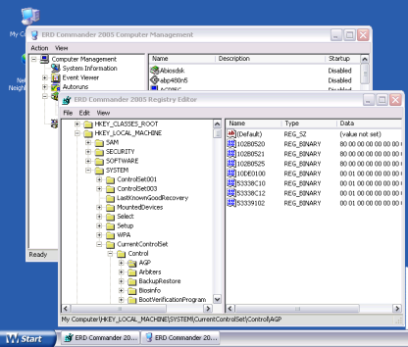
Microsoft Diagnostics and Recovery Toolset
Powerful tools to accelerate desktop repair
ERD Commander
Boots unstable or unbootable systems so you can:
  Use Wizards to diagnose and repair issues
  Reset local account passwords including Administrator
  Safely recover deleted files
  Edit the Windows registry, manage drivers/services
  Access unbootable machines via the network

Slide 9









Microsoft Diagnostics and Recovery Toolset
Powerful tools to accelerate desktop repair
ERD Commander Tools
Repair Systems, Recover Data, and Diagnose Issues
 | Service and Driver Manager |  | File Sharing/Map Network Drive
 | Regedit |  | System Restore
 | Disk Management |  | Hot fix Uninstall
 | Event Log |  | File Restore
 | Computer Management |  | Crash Analyzer Wizard
 | System Info |  | Locksmith
 | Command Prompt |  | Disk Commander
 | Search |  | Disk Wipe

Slide 10
Microsoft Diagnostics and Recovery Toolset
Powerful tools to accelerate desktop repair
Tool Categories in ERD Commander
  Admin Tools
  Network Tools
  System Tools

Slide 11
Microsoft Diagnostics and Recovery Toolset
Powerful tools to accelerate desktop repair
ERD Commander Tools: Admin Tools
Repair Systems, Recover Data, and Diagnose Issues
Service and Driver Manager
File Sharing/Map Network Drive
Regedit
System Restore
Disk Management
Hot fix Uninstall
Event Log
File Restore
Crash Analyzer Wizard
Computer Management
Locksmith
System Info
Disk Commander
Command Prompt
Disk Wipe
Search

Slide 12
Microsoft Diagnostics and Recovery Toolset
Powerful tools to accelerate desktop repair
Service and Driver Manager
Allows access to offline system’s Service Manager and Driver manager interfaces
RegEdit
Admin may manipulate the down PC’s registry
Disk Management
Disk management console
is available for disk repair operations
Event Log
Access to down system’s
Event Viewer

Slide 13
Microsoft Diagnostics and Recovery Toolset
Powerful tools to accelerate desktop repair
System Info
Admin may run System Info utility on down PC to better understand PC’s installed state
Computer Management
Access to tools in computer management
Command Prompt
Access to system command prompt so command line utilities may be used on down PC
Search
Utility can search offline PC for files and more

Slide 14
Microsoft Diagnostics and Recovery Toolset
Powerful tools to accelerate desktop repair
ERD Commander Tools: Network Tools
Repair Systems, Recover Data, and Diagnose Issues
File Sharing/Map Network Drive
Service and Driver Manager
Regedit
System Restore
Disk Management
Hot fix Uninstall
Event Log
File Restore
Computer Management
Crash Analyzer Wizard
System Info
Locksmith
Command Prompt
Disk Commander
Search
Disk Wipe

Slide 15
Microsoft Diagnostics and Recovery Toolset
Powerful tools to accelerate desktop repair
File Sharing
Network provider is available for offline system
Share point may be created
Data, Hotfixes, other utilities, etc., may be copied from down PC over the network
May also map a network drive to another networked PC via the “Map Network Drive” feature

Slide 16
Microsoft Diagnostics and Recovery Toolset
Powerful tools to accelerate desktop repair
ERD Commander Tools: System Tools
Repair Systems, Recover Data, and Diagnose Issues
Service and Driver Manager
File Sharing/Map Network Drive
System Restore
Regedit
Hot fix Uninstall
Disk Management
File Restore
Event Log
Crash Analyzer Wizard
Computer Management
Locksmith
System Info
Command Prompt
Disk Commander
Search
Disk Wipe

Slide 17
Microsoft Diagnostics and Recovery Toolset
Powerful tools to accelerate desktop repair
System Restore
  Provides access to XP System Restore Points
  Works independent of the system’s bootable state
Hotfix Uninstall
  Lists all of a system’s hotfixes for user uninstall selection
  Works independent of the system’s bootable state
Locksmith
  Allows reset of local accounts including Administrator
  Requires physical machine access

Slide 18
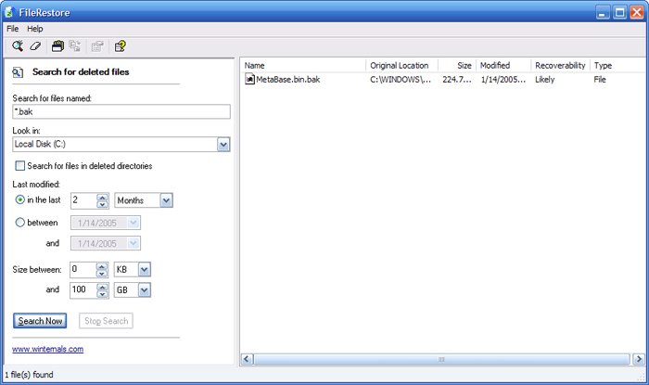
Microsoft Diagnostics and Recovery Toolset
Powerful tools to accelerate desktop repair
File Restore
Restore deleted files even if the Recycle Bin has been emptied
Parameters may be added to better identify which version you wish to restore

Slide 19
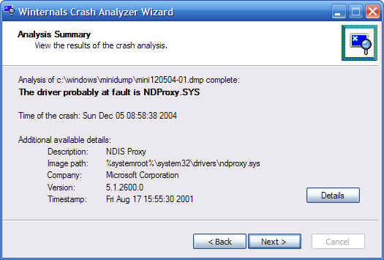
Microsoft Diagnostics and Recovery Toolset
Powerful tools to accelerate desktop repair
Crash Analyzer Wizard
Runs from within ERD Commander 2005 or from within Windows
Diagnose the cause of a blue screen crash
Provides both simplified and verbose results

Slide 20
Microsoft Diagnostics and Recovery Toolset
Powerful tools to accelerate desktop repair
Disk Commander
  Recover deleted and/or damaged files
  Detect historical or old partitions and regenerate a new partition table for it
  Navigate with a user friendly wizard interface
Disk Wipe
  Ability to wipe at the volume level or the entire physical disk
  Option to choose from 2 deletion algorithms.
  On par with the DOD’s standards of wiping a drive

Slide 21
Microsoft Diagnostics and Recovery Toolset
Powerful tools to accelerate desktop repair
Additional Utilities Provided to run inside
of a functional Windows Operating System:
  File Restore*
  Crash Analyzer*
  Insight for Active Directory
* Also included in ERD Commander

Slide 22
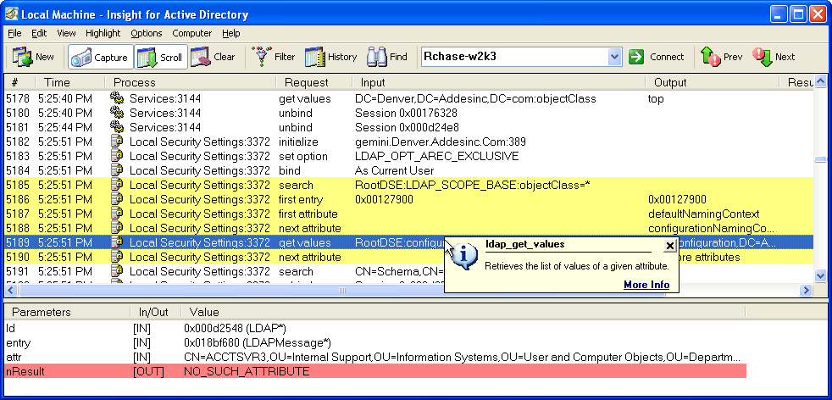
Microsoft Diagnostics and Recovery Toolset
Powerful tools to accelerate desktop repair
Insight for Active Directory
Monitor client to Active Directory LDAP activity in real-time
Identify client LDAP communication problems

Slide 23

Addressing Key Enterprise Customer Pain
Microsoft Diagnostics and Recovery Toolset
Experience / Scenario
Application Compatibility
Accelerate deployment
Make compatibility testing fast and painless
Improve PC Manageability – Drive Down TCO in the OS
Simplify corporate image management
Enable anytime, anywhere secured access to applications
Help lock desktops down
Flexible Computing Models (e.g. Thin client computing)
Mix and match rich and thin clients in their environment
Enable better application provisioning
Diagnostics and Help Desk
Simplify problem resolution and tracking/Prevent Future Issues
Increase recovery time and functionality
Protect data in lost or stolen machines
Protect sensitive data and intellectual property
Make PCs Safe to Use – Anywhere, Any Time
Ensure laptops are virus-free before connecting to corpnet and enable vulnerability assessment
Bring new data protection solutions. Lock desktops down.
Software Asset Management
Monitor usage and ensure deployment policy compliance.
Enable real time tracking of software usage.

Slide 24





The Vision: The Optimized Desktop
Delivering the most cost effective & flexible Windows desktop management solution
Agile
Intelligently Managed
Locked Down
Cost Effective
Accelerate deployment
Maximize accessibility
Flexible computing
Control access
Enhance interoperability
Protect & recover data
Identify threats
Reduce Helpdesk cost
Real time asset mgt
Maximize productivity
Application mgt
Patch mgt
Diagnosis & Repair
Asset management
Making the vision a reality with
Software Assurance for the Windows desktop

Slide 25
Resources
Website for Microsoft Desktop Optimization Pack for Software Assurance
  http://www.windowsvista.com/optimizeddesktop

Slide 26
Questions?

